Slide 1
Overview of Computer Memory
Concurrent Programming with C# Nikolay Pavlov

Slide 2
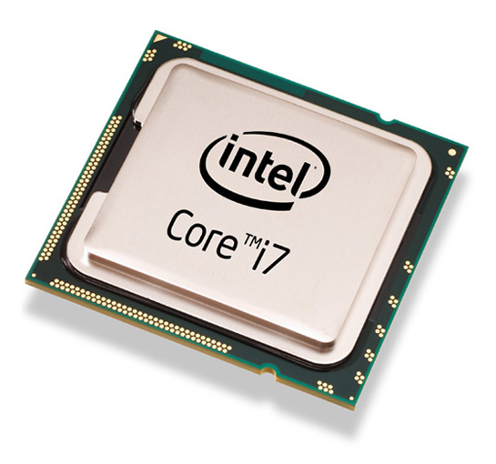
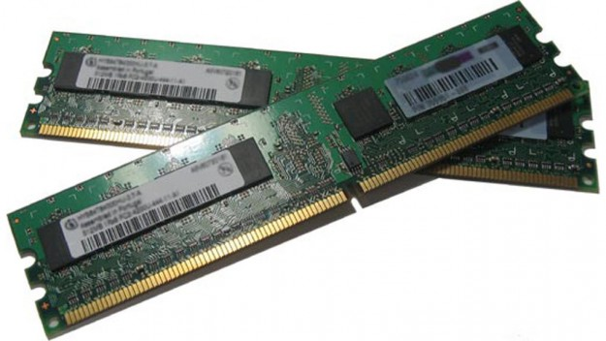

Computer Architecture
CPU
Processor
Core
Memory
RAM
Cache, levels of cache
Peripherals
Data
Commands
Data

Slide 3
Memory
RAM – main memory
Cache
Very fast memory, from a few KBs to a few MBs
Cache is in levels: L1, L2 and so on; every next level is slower and larger
Registers: temporary units of memory within the CPU
Very fast
Global for the CPU core
A limited number of them (10-50)
CPU instructions often require them for input and output

Slide 4
Accessing Memory
Memory is accessed by address
Address – a numeric value that points to a location in memory
Byte – the smallest unit of memory you can address
CPUs almost never access a single byte of memory
Example:
If you have 1,000 bytes of memory, addresses will be numbers from 0 to 999.

Slide 5
Virtual Address Space
Every application gets its own private range of addresses
For 32-bit applications, the range is between 0 and 0xFFFFFFFF
I.e., 32-bit applications can in theory address up to 4GB of memory
In practice, 32-bit applications can use up to 2 (3) GB of memory
This is regardless of how much physical RAM the computer has!
Virtual addresses are mapped to physical memory

Slide 6
Process Virtual Memory (32 bit)
Kernel Space
(2 GB)
0xFFFFFFFF
Kernel space:
Kernel and executive
Device Drivers
User Space:
Code, including DLLs
Data
Windows supports 1GB kernel and 3GB user space
Linux: 1GB and 3GB user space
0x80000000
User Space
(2 GB)
0x7FFFFFFF
0x00000000

Slide 7
Stack vs. Heap
Stack – small region memory, reserved for the code execution
Fixed size: defaults to 1MB for Windows
Stores local variables of functions and other data like return address
May store also input and output parameters of functions
Heap – all the rest of the available memory your code can allocate and use
Used when you allocate memory (in languages like C), or
For reference types like arrays and objects for languages like C# and Java

Slide 8
User Space – 2GB
64 K reserved
0x7FFFFFFF
Heap
Stacks
0x7FFEFFFF
Stacks
One per thread
Grow downwards
1MB max size (default)
Code
Application Code, incl. DLLs
Heap
All allocated data goes there
.NET: the data of all reference types goes there
Code
0x00010000
64 K reserved
0x00000000

Slide 9
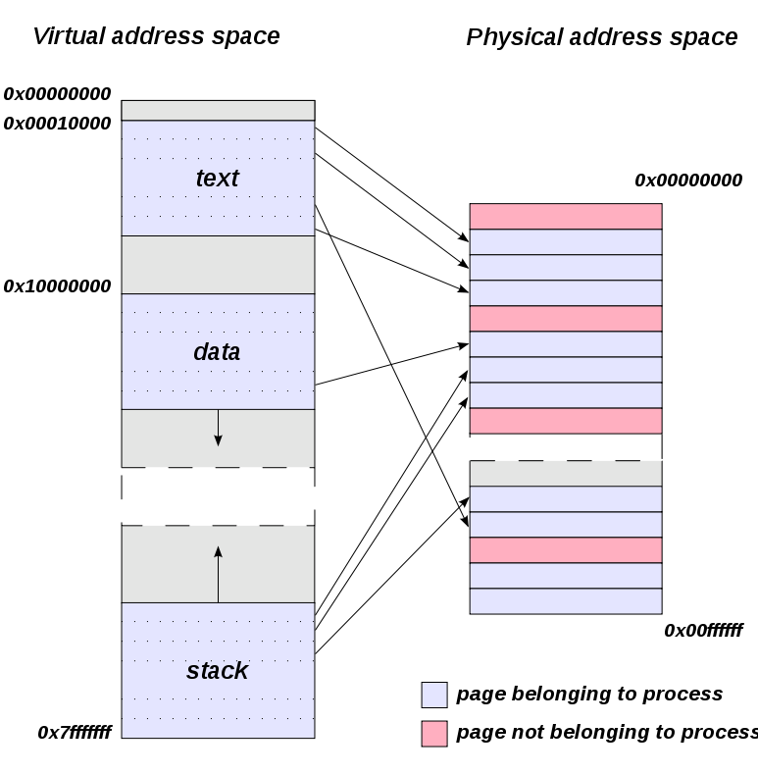
Virtual Address Space and Physical Memory
Courtesy of Wikipedia; By Traced by User:Stannered, original by en:User:Dysprosia

Slide 10
Physical Memory
RAM
Hard disks
When RAM is not enough, memory content get swapped to the hard disk
When content is necessary for a program to run, it is loaded back into RAM

